Slide 1
Compression of NMT Models
Via
Pruning
Team - Optimal Brain Damage

Slide 2
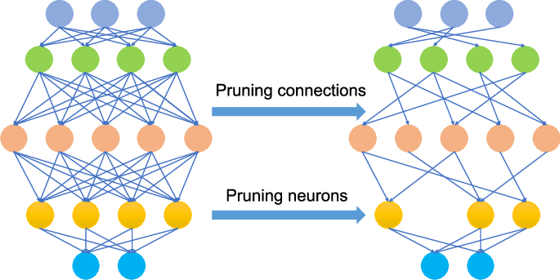
What is Pruning?
Pruning is the practice of removing parameters (which may entail removing individual parameters, or parameters in groups such as by neurons) from an existing network.
Types of Pruning
Structured pruning involves pruning entire neuron, filters etc.
Unstructured Pruning involves pruning individual parameters based on some saliency criteria.

Slide 3
Why do we need pruning?
Efficiency Boost: Pruning trims unnecessary weights in over-parameterized neural networks, enhancing efficiency, decreasing floating operations per second.
Suboptimal Optimisation: Pruning prevents getting stuck in suboptimal local minima, promoting robust feature learning.
Generalization Improvement: Pruning improves neural network generalization by removing irrelevant weights, optimizing for specific tasks.

Slide 4
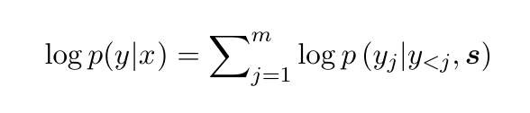
Our Task
Neural Machine Translation: It involves translating a sentence X of one language (source language) to sentence y of another language (target language).
A basic form of NMT consists of two components:
(a) an encoder which computes a representation s for each source sentence
(b) a decoder which generates one target word at a time and hence decomposes the conditional probability as:

Slide 5
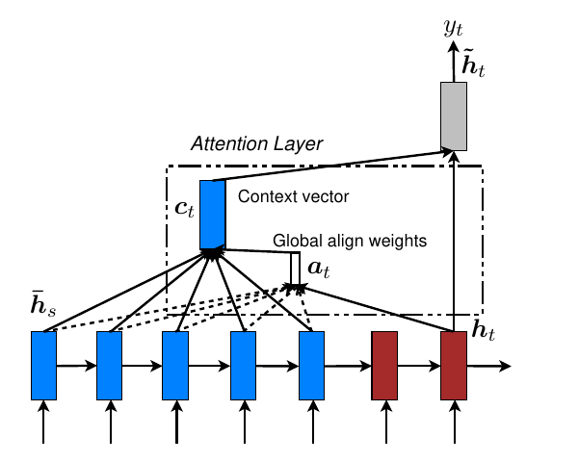
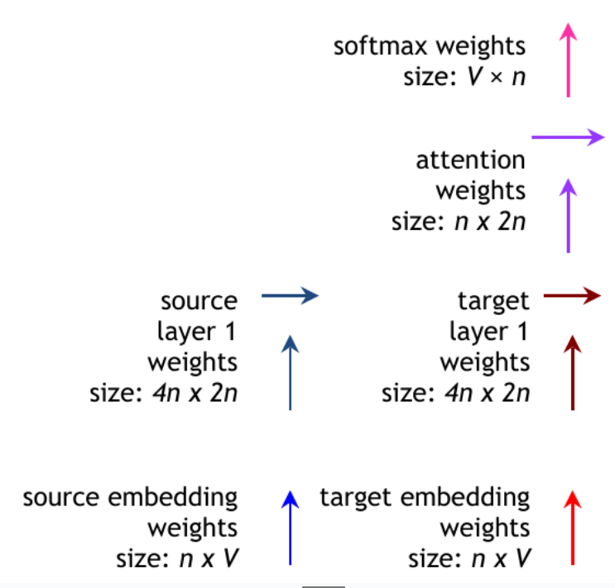
Our Model
Our model’s architecture is based on the model by (Luong et al. 2015) which introduced global and local dot product attentions.

Slide 6
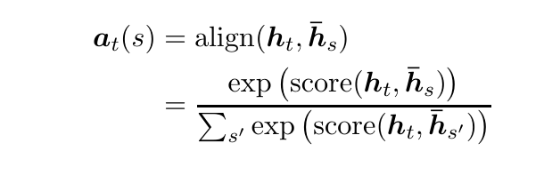
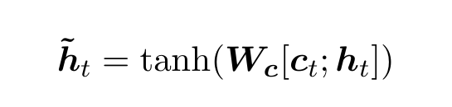
Attention in model
Calculate the alignment score of current
target hidden state with each source
hidden state .
A global context vector is then computed as
the weighted average over all the source states.
Combine the information from source context
and target hidden layer to produce an attentional
hidden state .

Slide 7
More details:
We use only 1-layer of LSTM (as compared to original 4) stacked in decoder and encoder.
We use IWSLT 2014 German-English dataset (150K training sentences).
Both these points bring training time from few days to few hours, speeding our experiments.

Slide 8
Pruning Schemes implemented in our paper
(See et al. 2016)
Class-blind magnitude pruning: Sort the parameters of whole model. Find the threshold for pruning such that x% of weights is pruned.
Class-uniform magnitude pruning: Sort the parameters of each class of weights and within each class find the threshold for pruning such that x% of weights in all classes of weights are pruned.
Class-distribution magnitude pruning:For each class c, weights with magnitude less than lambda sigma_c are pruned. Here, sigma_c is the standard deviation of that class and lambda is a universal parameter chosen such that in total, x% of all parameters are pruned.

Slide 9


Slide 10
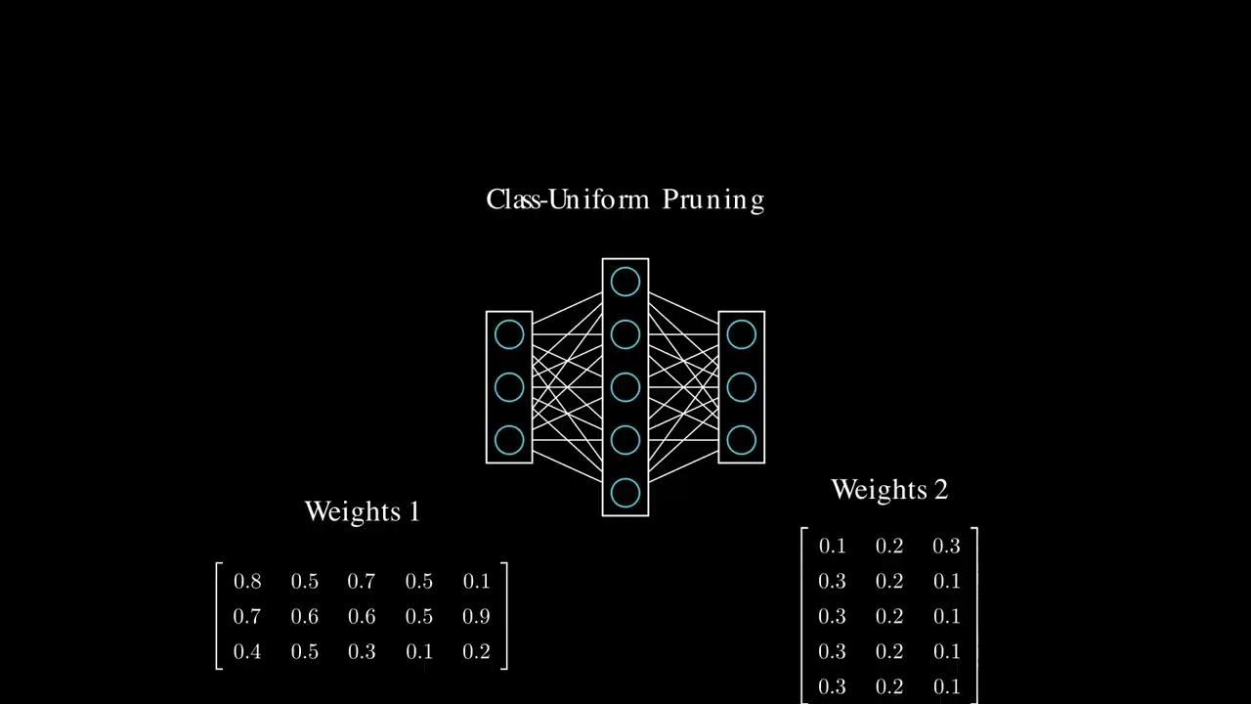

Slide 11
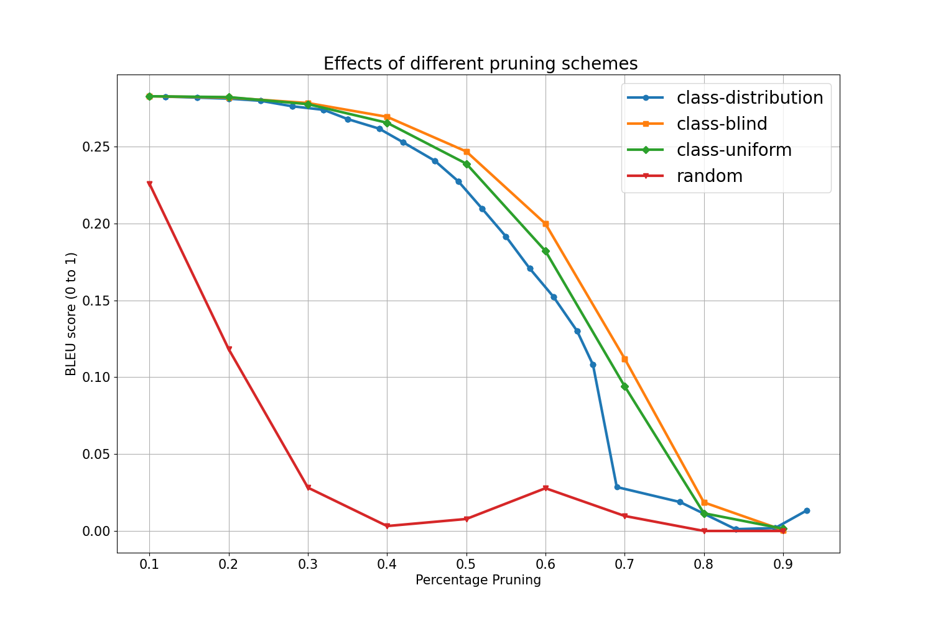
Comparison of these pruning schemes with baseline
Class blind is better - Adheres to the principle
that pruning weights is least damaging when
those weights are small regardless of their
locations in the architecture.
Other methods prune weights in classes
which have higher magnitudes and can be
more important.

Slide 12
Retraining and Sparse from Begin
What is retraining?
We continue to train the remaining weights by minimal change in hyperparameters, but maintain the sparse structure introduced by pruning.
How does retraining help?
During pruning since we remove the connections our accuracy will decrease. Now by retraining the network is encouraged to rely on the remaining important features and adjust their weights to capture the relevant patterns in the data.
Training with sparse form from begin
We prune our model maintain the sparsity structure and reinitialise the weights for training.

Slide 13
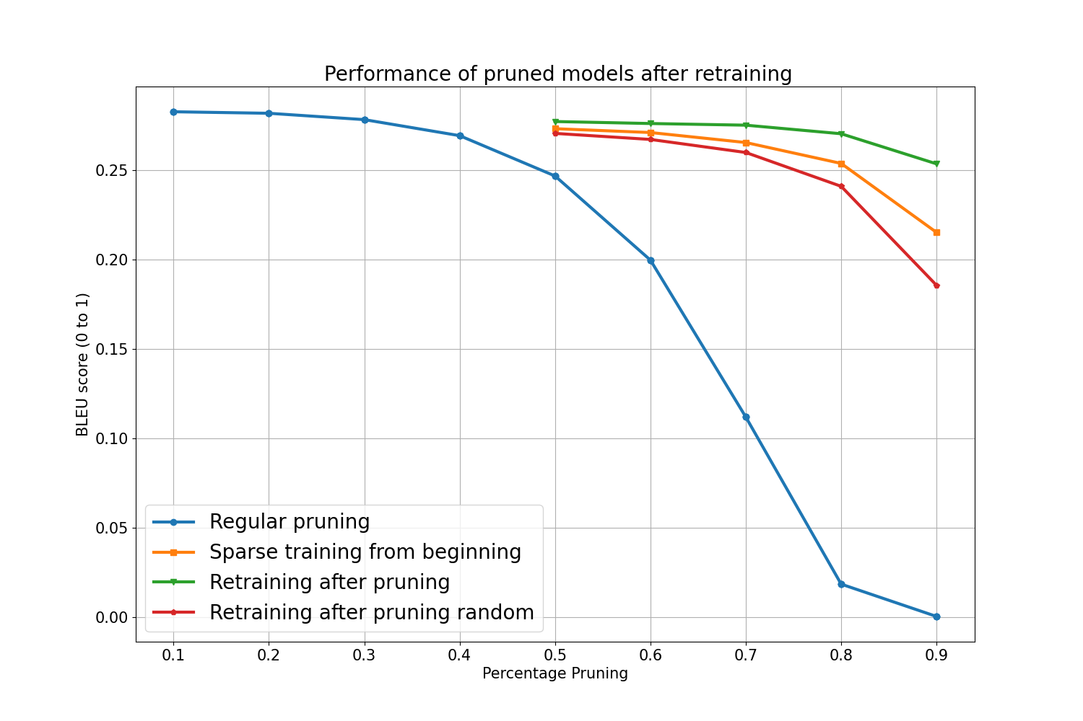
Effect of Retraining
Retraining improves performance on high pruning %age and acts as regularizer for low %ages.
Sparsity structure alone contains useful information about redundancy

Slide 14
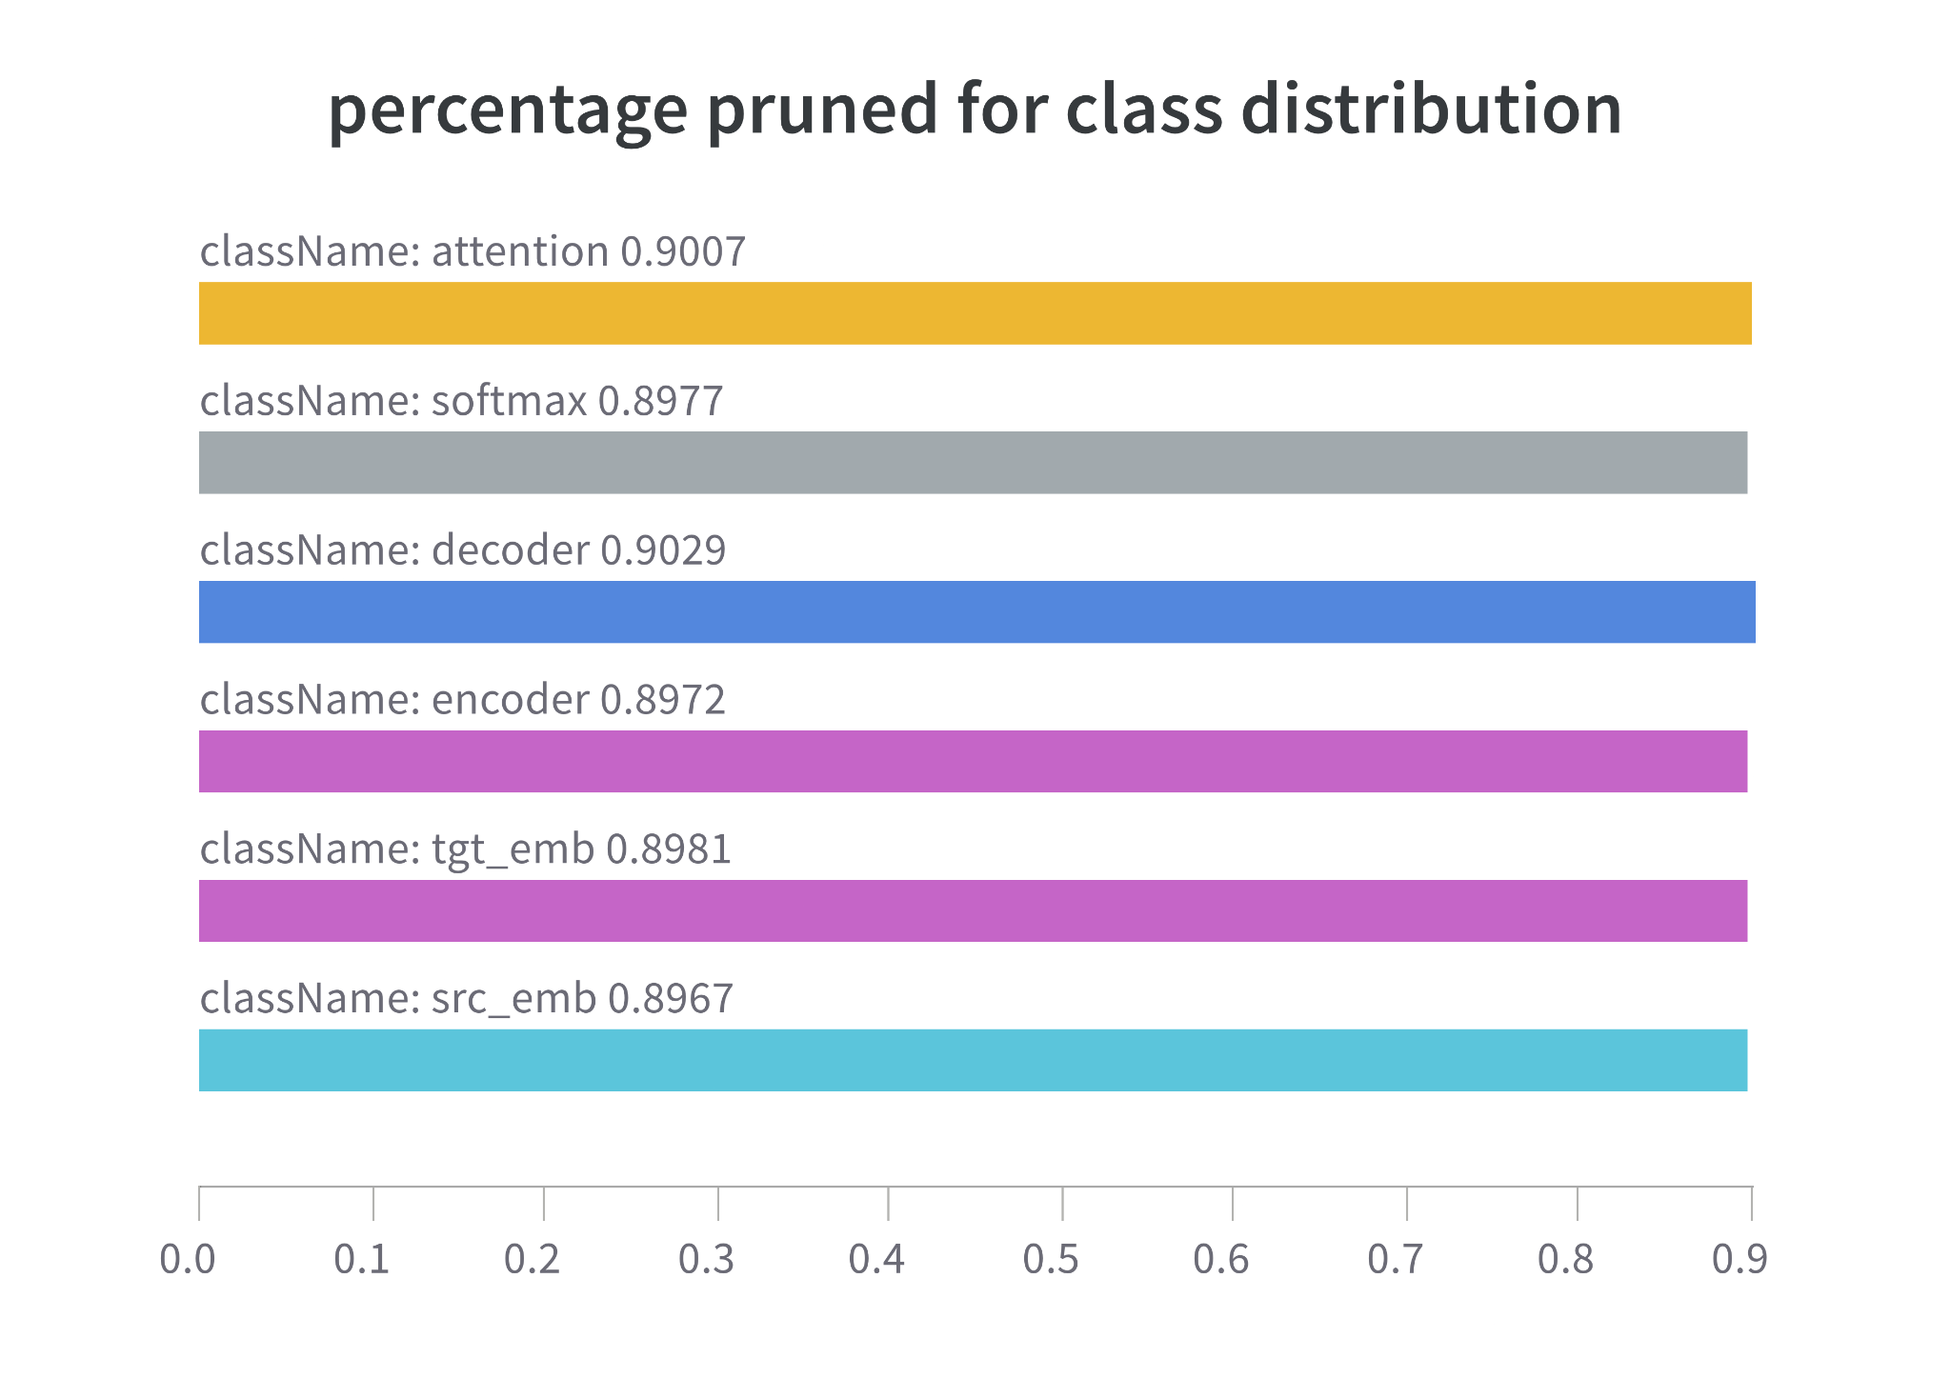
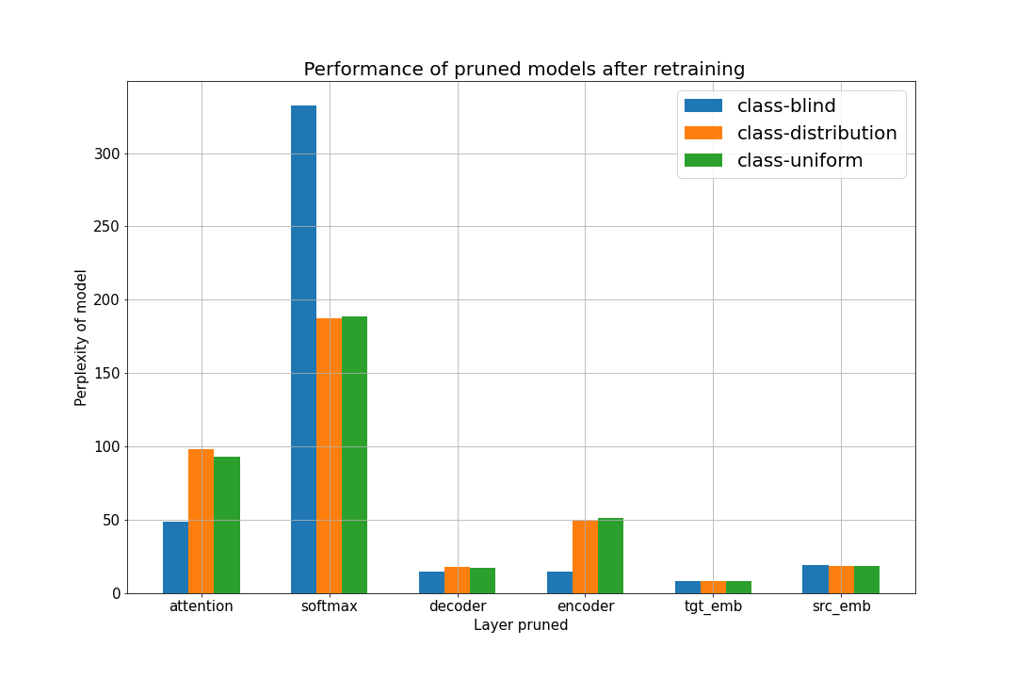
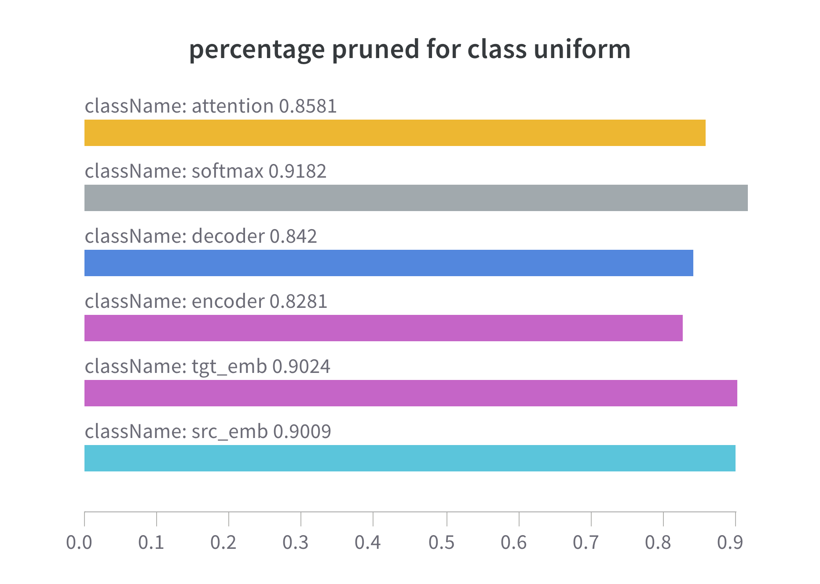
Perplexity Change with pruning of each class of weights

Slide 15
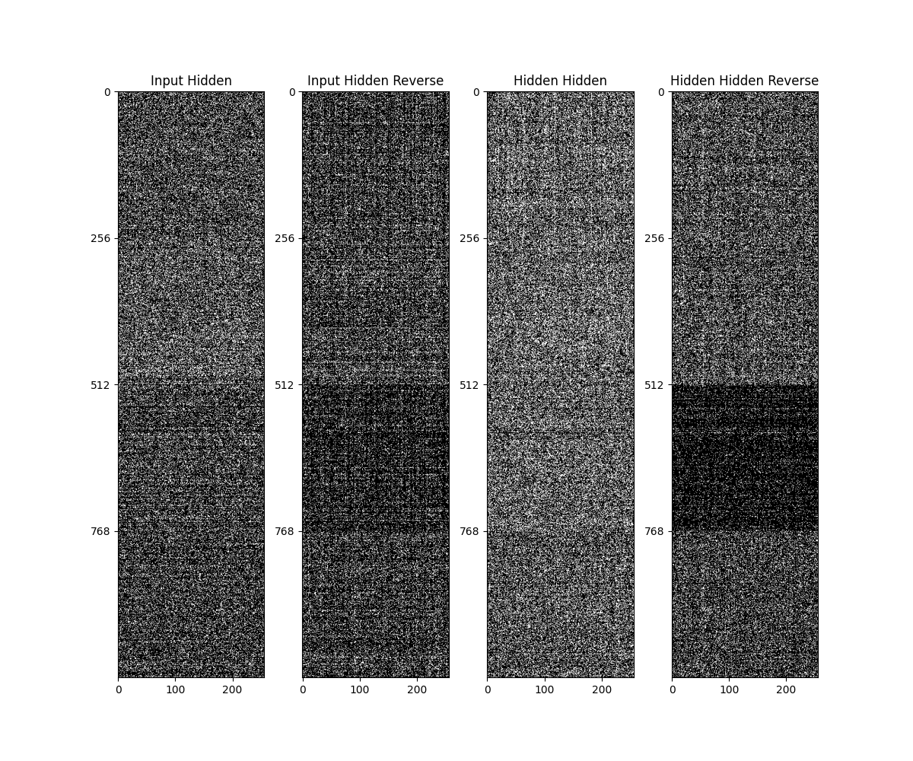
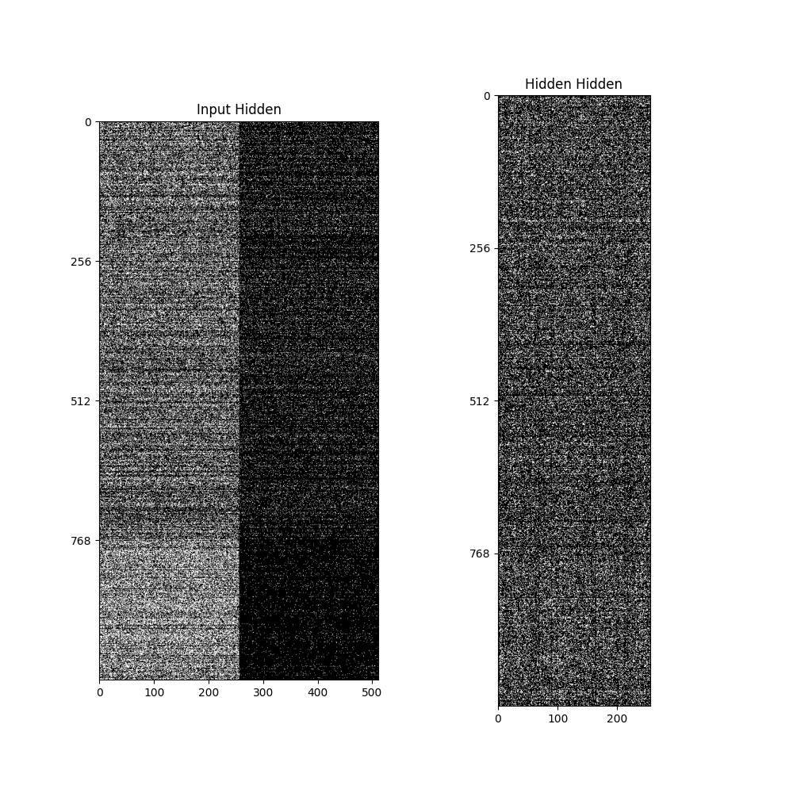
Encoder and Decoder Weights Visualisation
Input gate
Forget gate
Output gate
Input
Normal Context

Slide 16
What we have covered till now?
Pruning Types
Class-blind magnitude pruning
Class-uniform magnitude pruning
Class-distribution magnitude pruning
Random Pruning
Experiments
Bleu score of different pruning schemes before and after retraining
Perplexity change with each weight class
Percentage Pruned within each weight class
Visualisation of Encoder and Decoder weights

Slide 17
Going beyond magnitude pruning !!
:)

Slide 18
Shortcomings of Magnitude Pruning
Magnitude of weights as a saliency criterion is only a heuristic to prune the weights.There can be more explainable, rigorous and principled methods.
Prune-retrain cycles which are used to get the optimal results are costly, require additional hyperparameters (learning rate, no of epoch etc.) and may have architectural constraints.

Slide 19
SNIP: Single Shot Network Pruning based on connection sensitivity (Lee et al. 2019)
It prunes the connections at initialization (before training) and training normally.
Why is there even a need for pruning before training?
It identifies saliency criterion based on connection sensitivity that identifies structurally important connections in the network for the given task before training starts.
This eliminates the need for both retraining and the complex pruning schedule while making it robust to architecture variations.

Slide 20
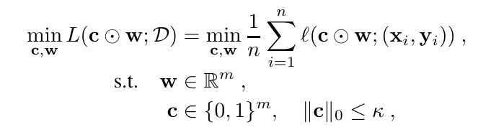
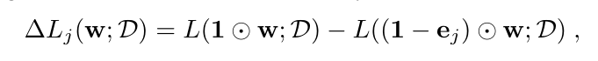
More details on SNIP
Saliency criterion: Connection sensitivity involves
removing the connection and observing the change
in the network's output (loss function value)
compared to the original network.
Ideally, we would want to remove each weight w once
(by setting some mask c = 0), to check for effect on loss:

Slide 21
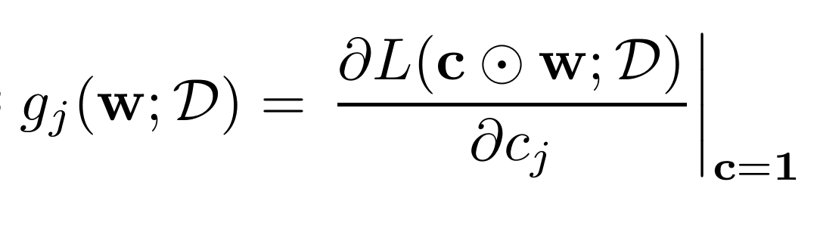
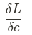
More details on SNIP
However, we cannot do that in reasonable time, so
we approximate the effect by calculating :
Notice, that it is gradient with respect to mask, and not original weights.
This approximates the effect of change of loss if some mask is made 0, or equivalently a respective weight pruned.

Slide 22
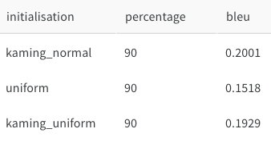
Effect of Initialisation
Initialisation matters a lot since the connection sensitivity is performed on untrained weights.
It should be variance scaled for the method to not depend on architecture variations.

Slide 23
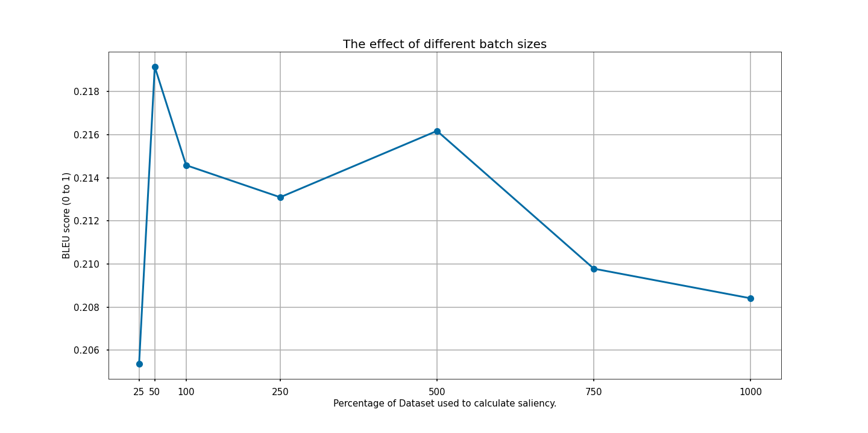
Effect of batch size to find saliency
In SNIP results might also change with how much data we show, before actually calculating the gradients to find saliency.
The graph shows that just 50/1000 portion of dataset is enough to make a good predictions on pruning weights.

Slide 24
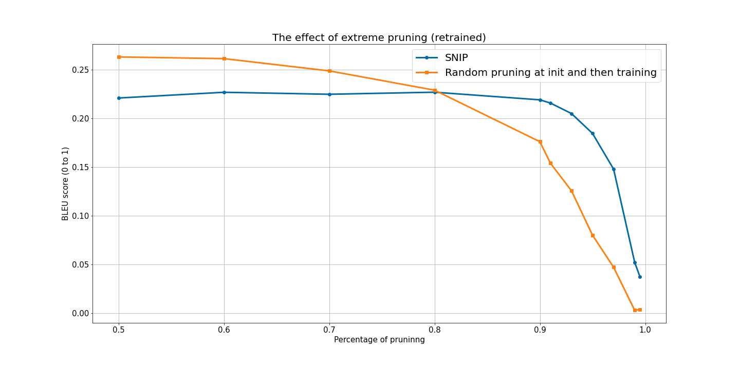
Comparison with Random baseline
SNIP performs better at more extreme
puning percentage.
Another thing to notice is that original
paper tested SNIP only on CNNs and
RNNs for image classification (RNNs too).
In our NMT task, we find that performance is
not always optimal.

Slide 25
Problems With SNIP
Connection sensitivity is suboptimal as a criterion because the gradient of each weight might change dramatically after pruning due to complicated interactions between weights.
Since SNIP only considers the gradient for one weight in isolation, it could remove connections that are important to the flow of information through the network.

Slide 26
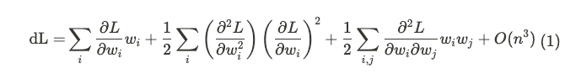
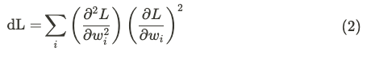
Optimal Brain Damage (LeCun et al. 1989)
Using Taylor’s expansion we can approximate change in loss, dL as:
Now since the model has converged, the first term is zero and we ignore the interaction and higher order terms what we finally get is:
Second derivative of the loss functions with respect to parameters is used a saliency measure.
Notes:
Why does this work?
Gradient pruning prunes the weights gradients with respect to whose are negligible as these weights do not cause more change the loss function so they must not be that important.

Slide 27
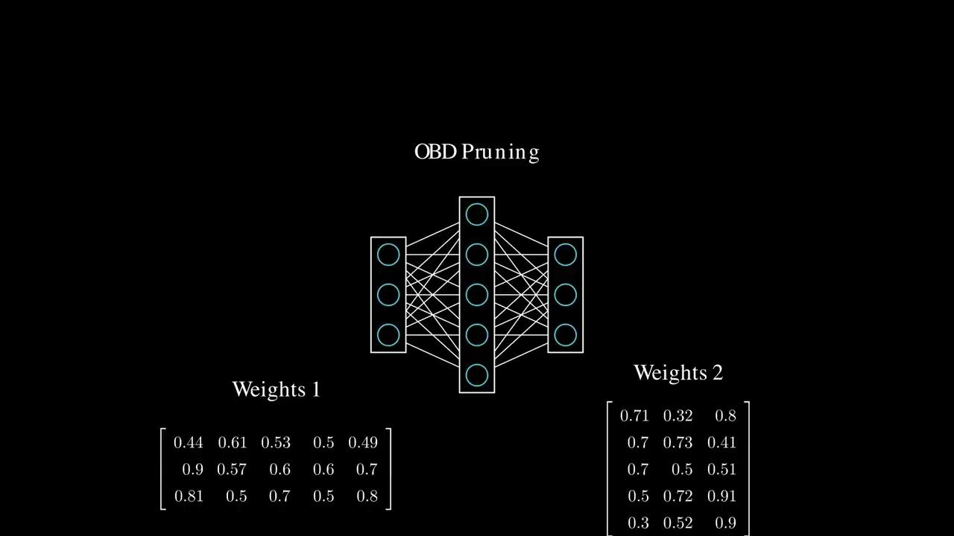

Slide 28
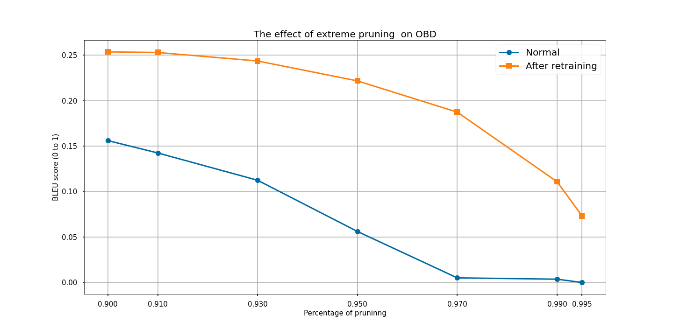
Effect of extreme pruning percentages on OBD

Slide 29
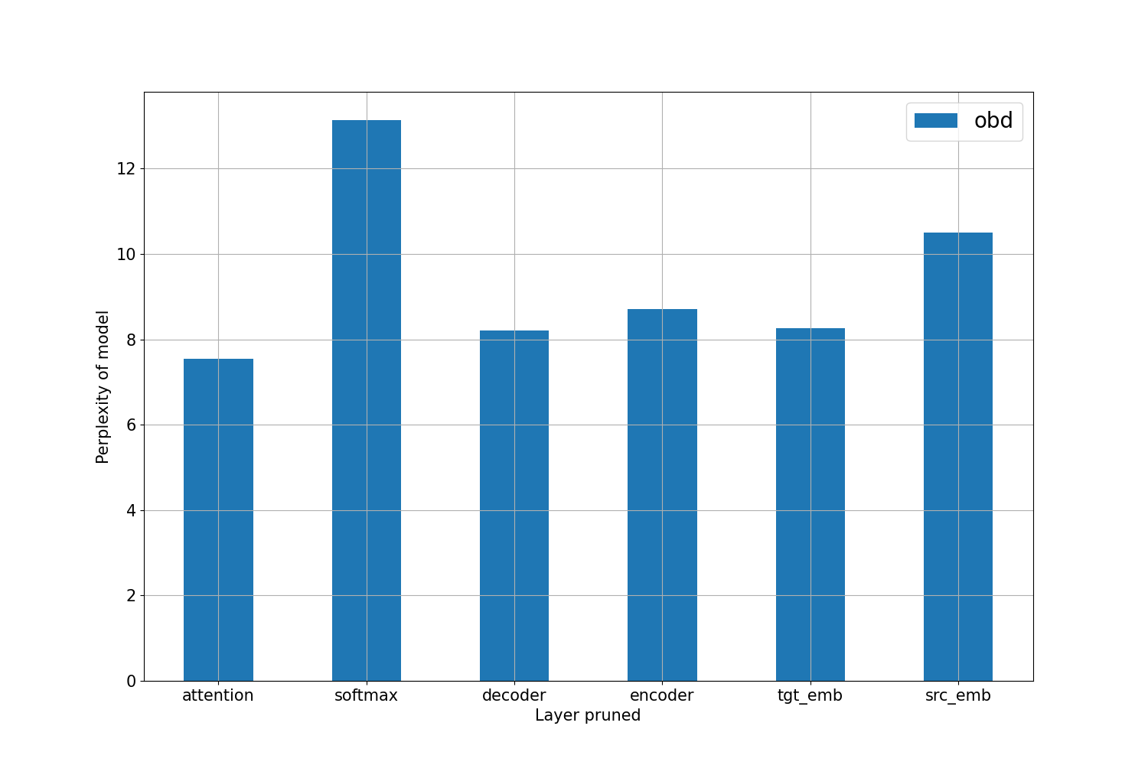
Perplexity Change by pruning each class of weights

Slide 30
Comparisons Between All Pruning Schemes Seen Till Now
We performed various experiments to compare the pruning schemes in context to find their strengths more in view of our task

Slide 31
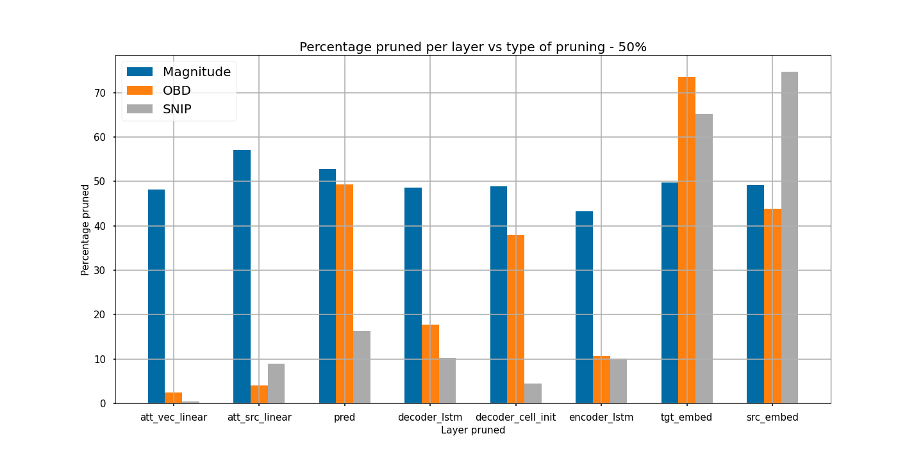
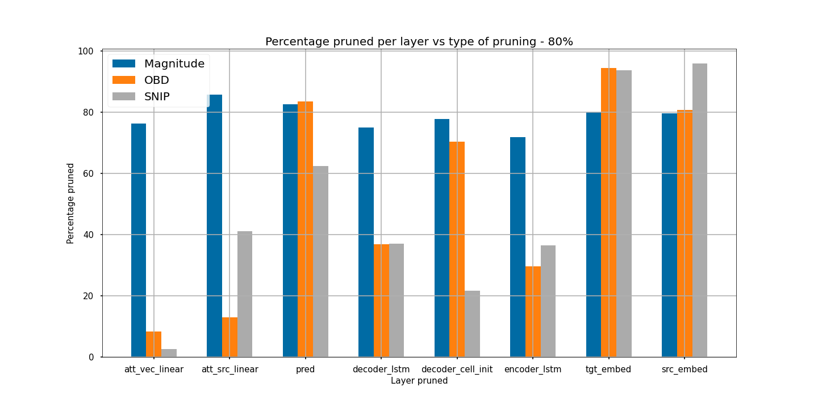
Percentage Pruned vs class type pruned
for 50 and 80 percent pruning
OBD and SNIP remove weights closer to initial lvls. This is actually good as later weights are considered to be more important.

Slide 32
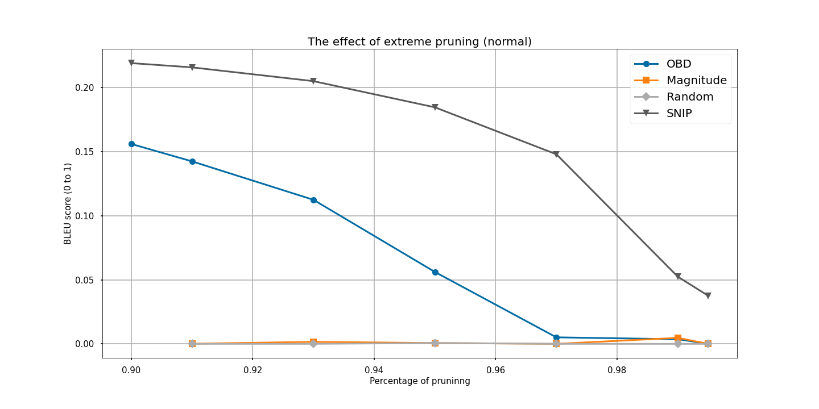
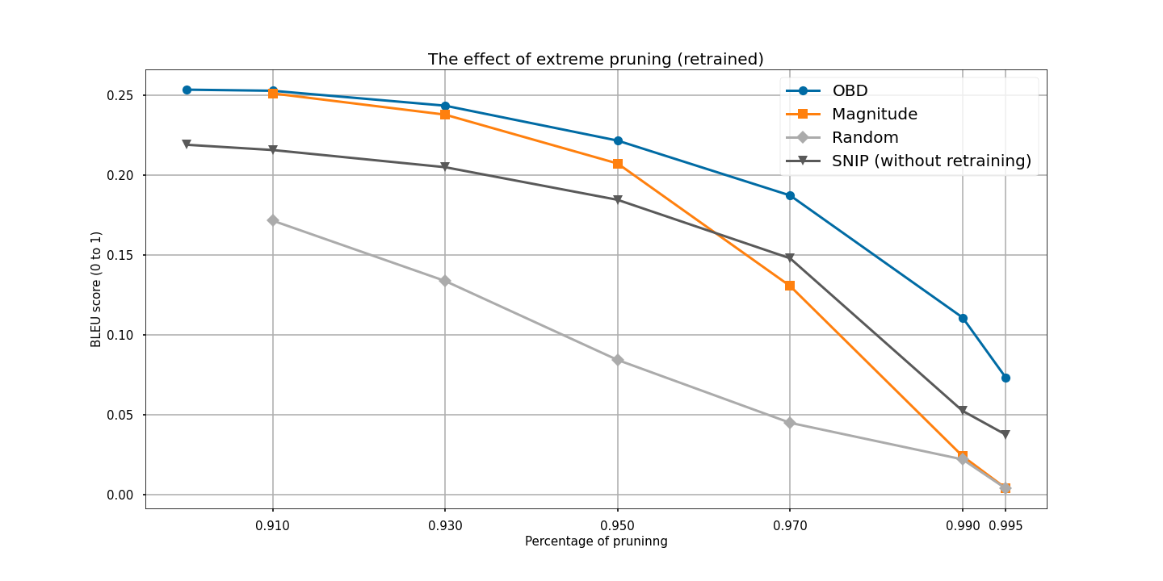
Effect of extreme pruning percentages comparison
SNIP was pruned at initialisation, rest are pruned after training.
Top-3 pruning schemes are shown after retraining. SNIP is shown as usual.
Both graphs seem to confirm that SNIP is good at extreme levels of pruning.

Slide 33
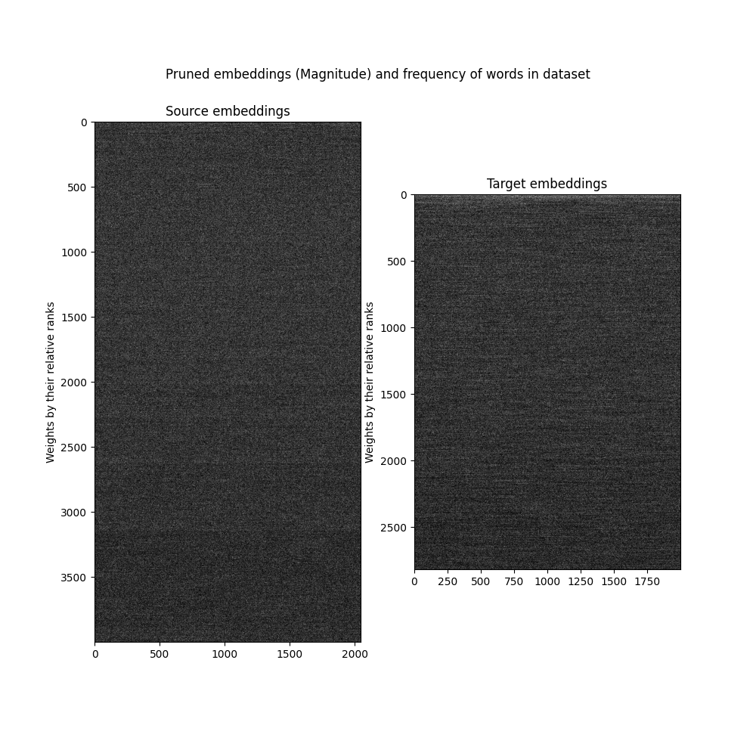
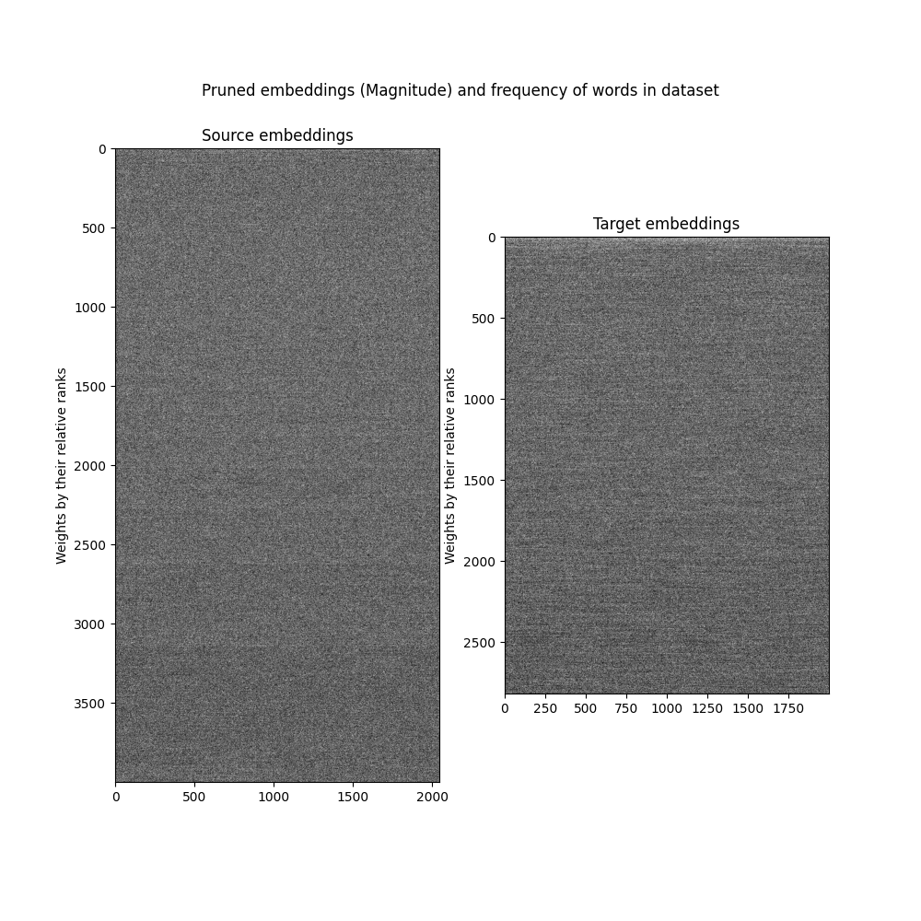
Effect of pruning on word embeddings
Do words used less in dataset get pruned?
Magnitude pruning

Slide 34
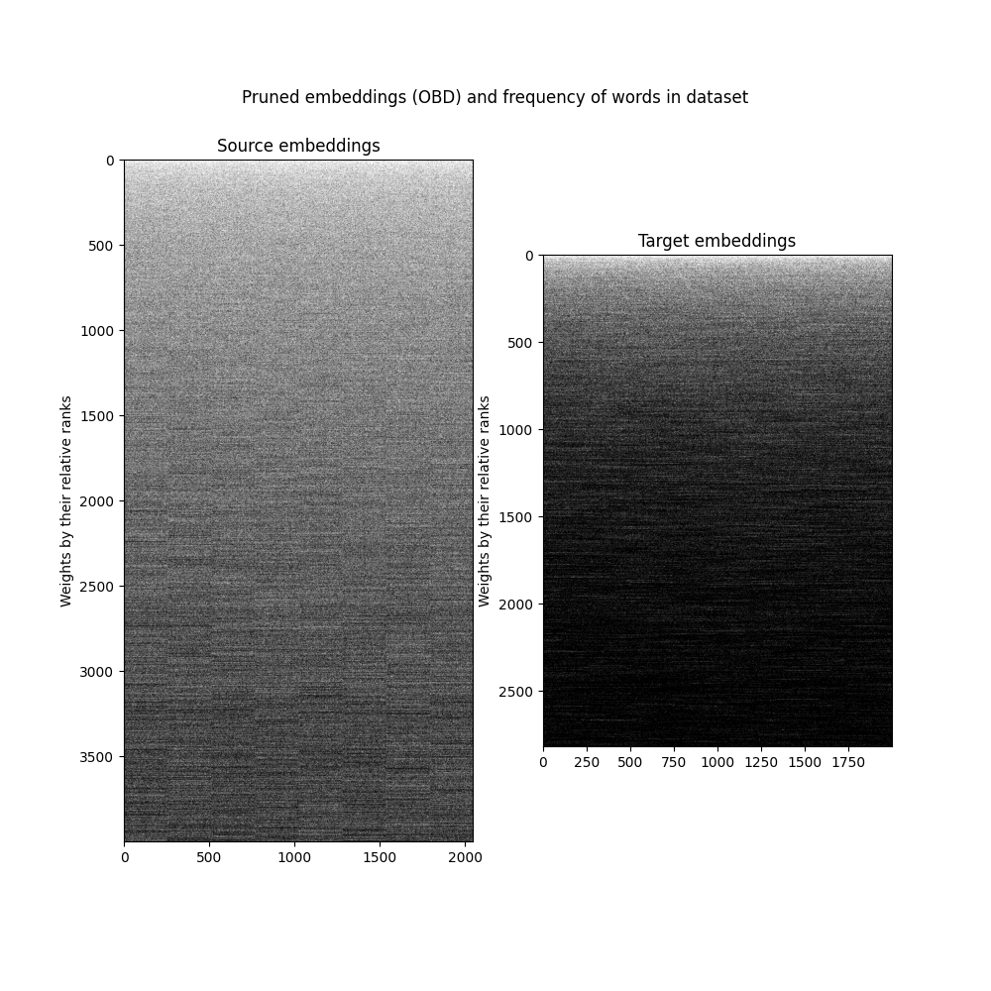
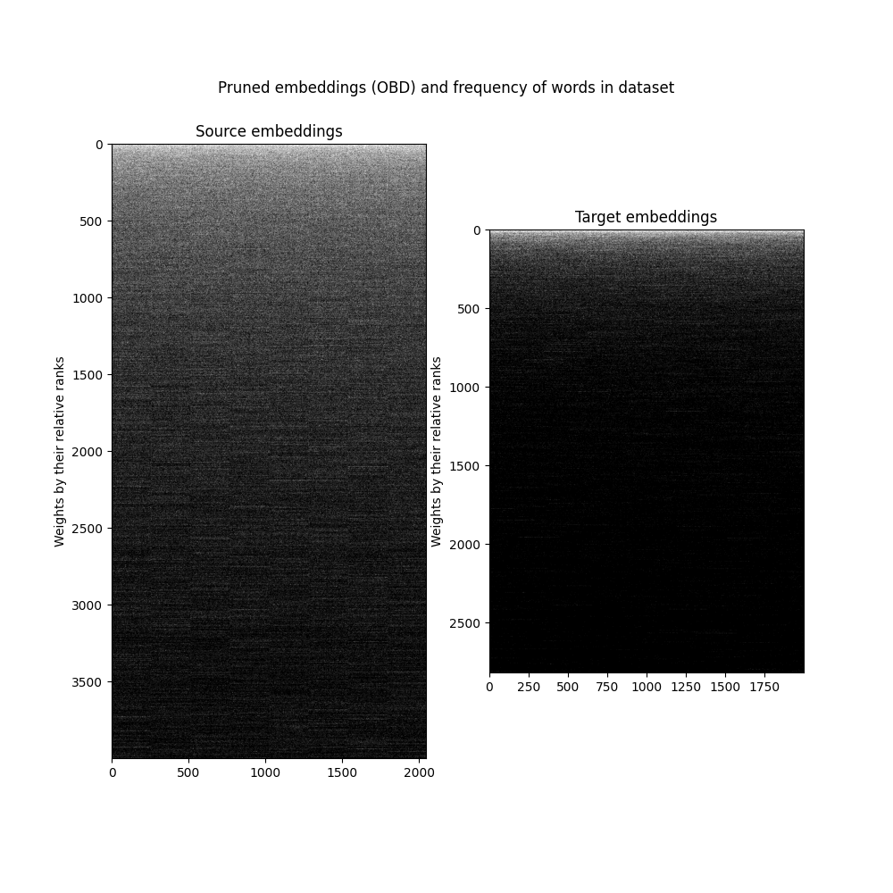
Effect of pruning on word embeddings
Do words used less in dataset get pruned?
OBD pruning

Slide 35
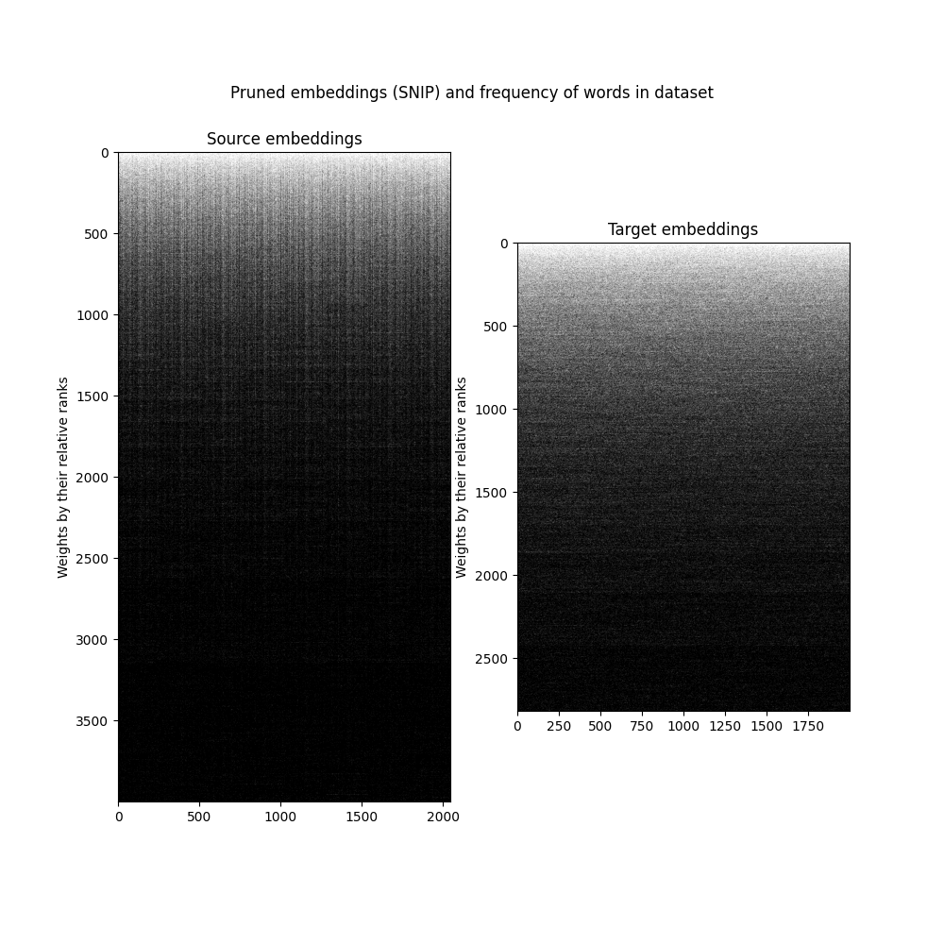
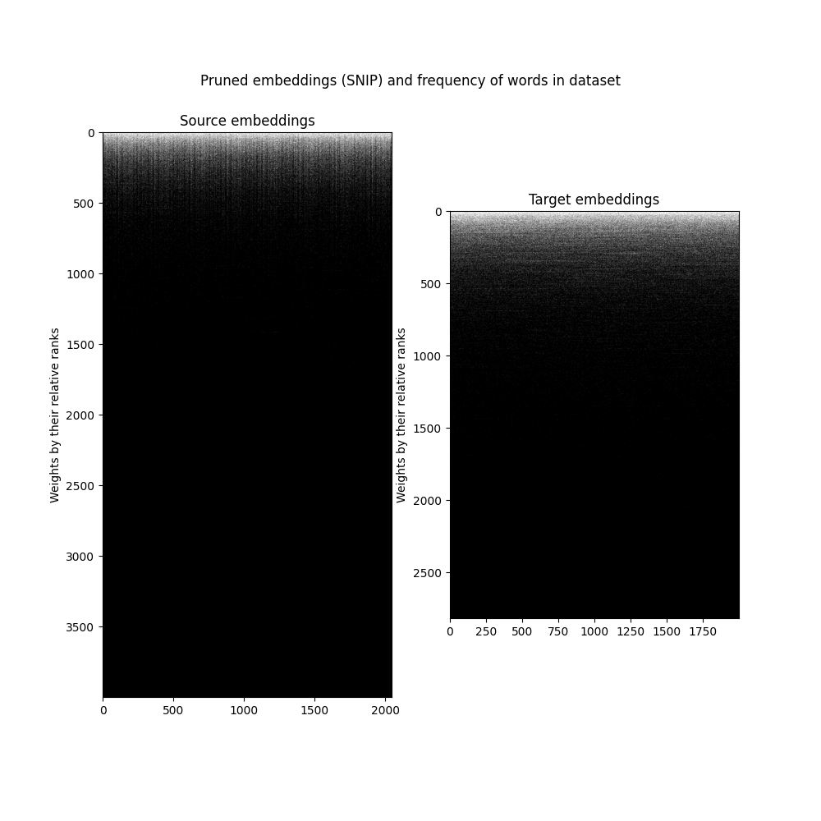
Effect of pruning on word embeddings
Do words used less in dataset get pruned?
SNIP pruning

Slide 36
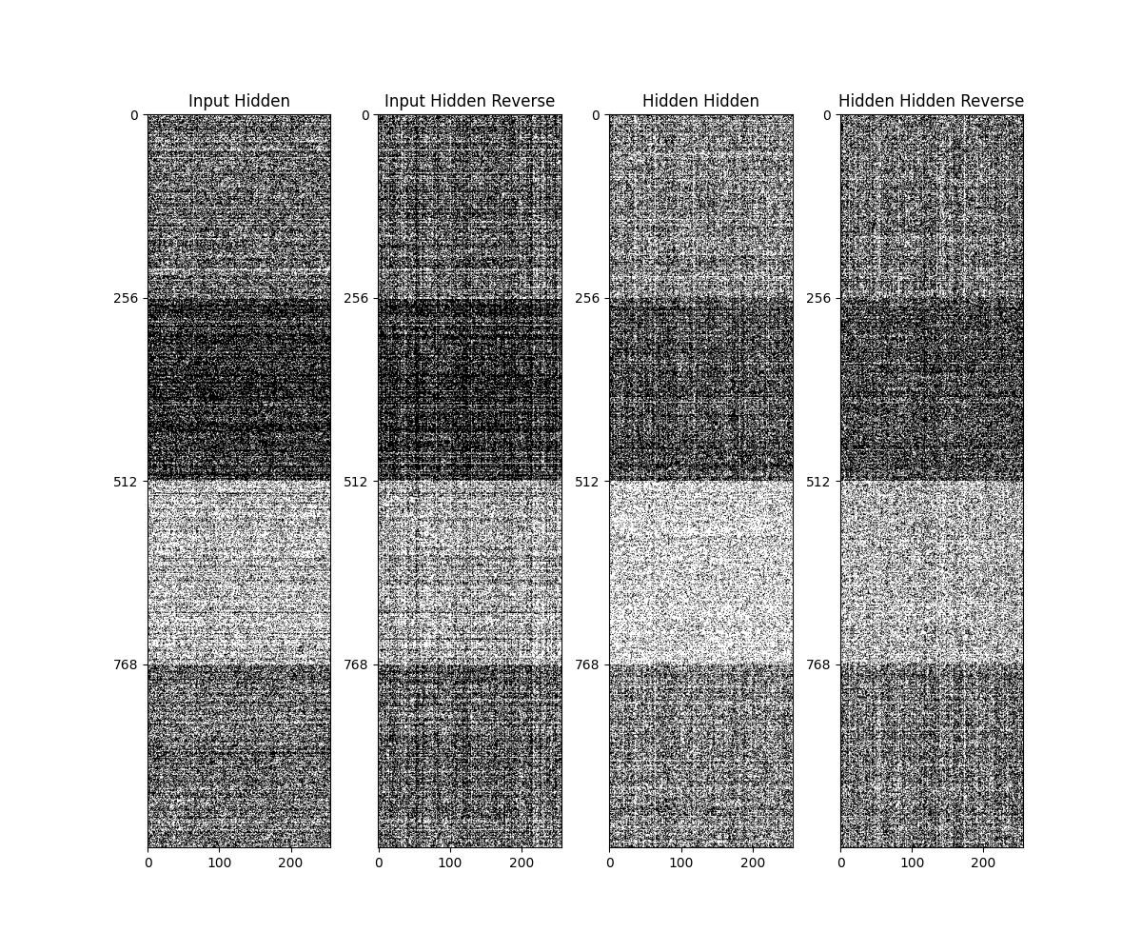
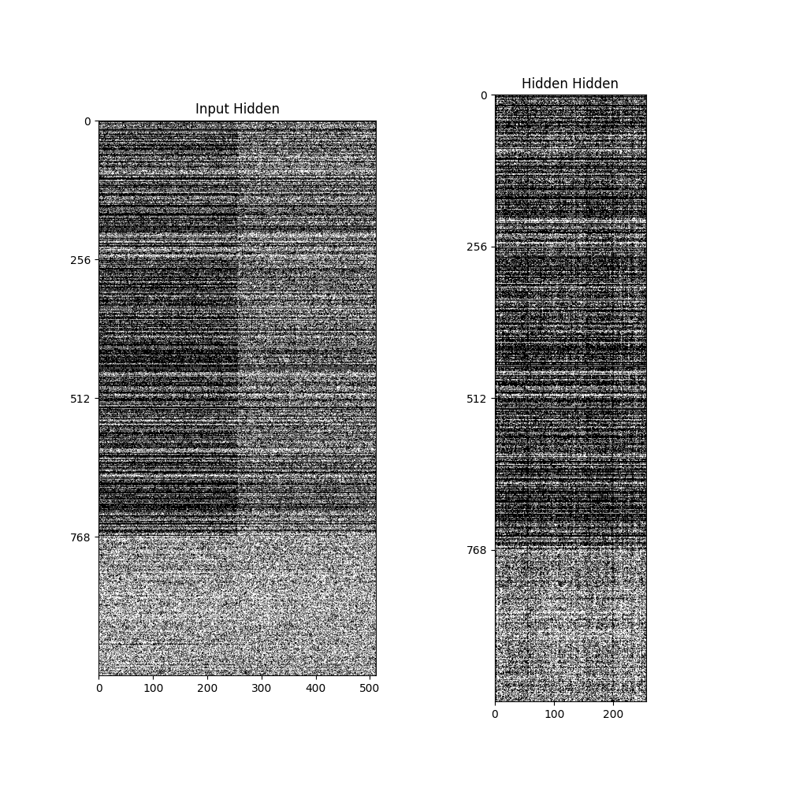
Visualisation of encoder-decoder weights
SNIP/OBD at 80% lvl
Input gate
Forget gate
Output gate
Input

Slide 37
Alignment of Attention Weights
Source: wenn ich sie fragen würde , die großen weltreligionen aufzuzählen , was würden sie sagen ?
Target: if i asked you to name the great religions of the world , what would you say ?

Slide 38
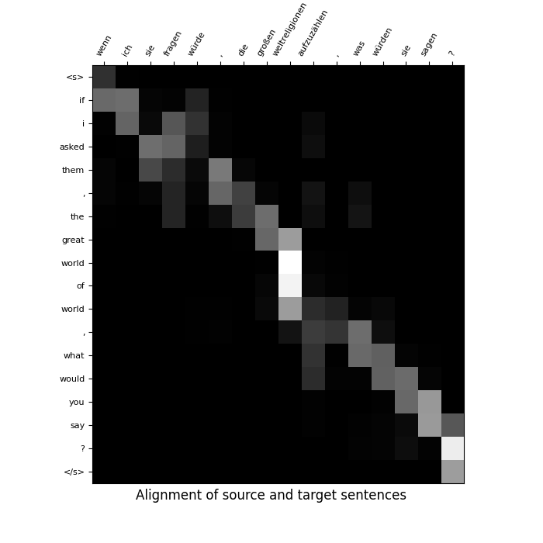
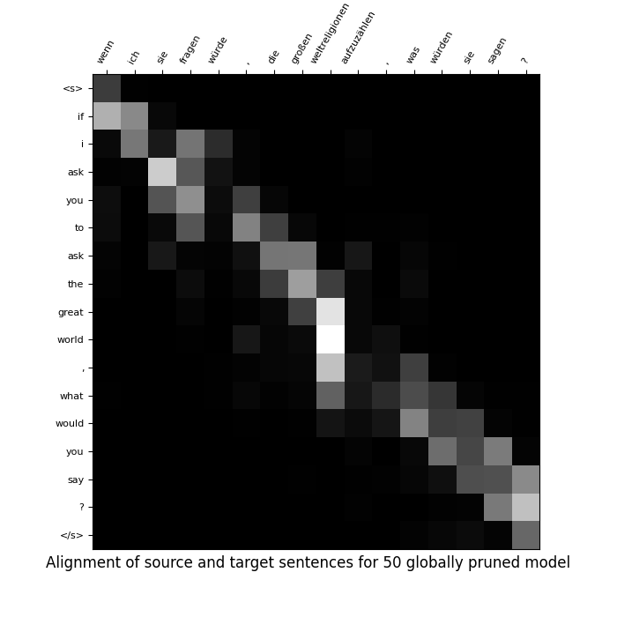
Predicted: If i asked them , the great world of world , what would you say ?
Predicted: If i ask you to ask the great world , what would you say ?

Slide 39
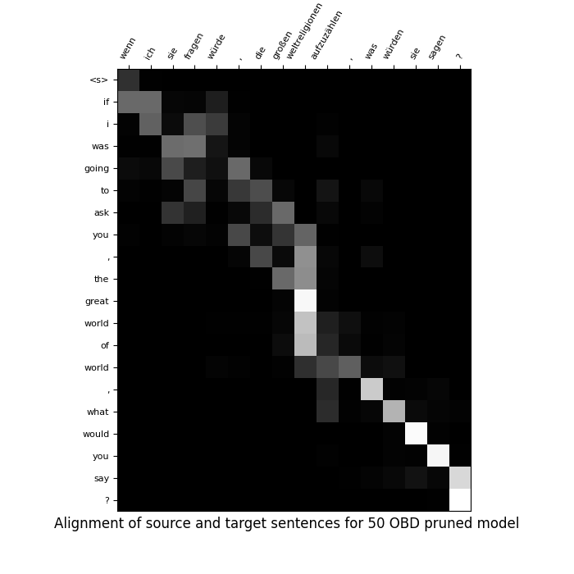
Predicted: If i asked them , the great world of world , what would you say ?
Predicted: If i would ask them to ask them the great world of course , what would you say ?

Slide 40
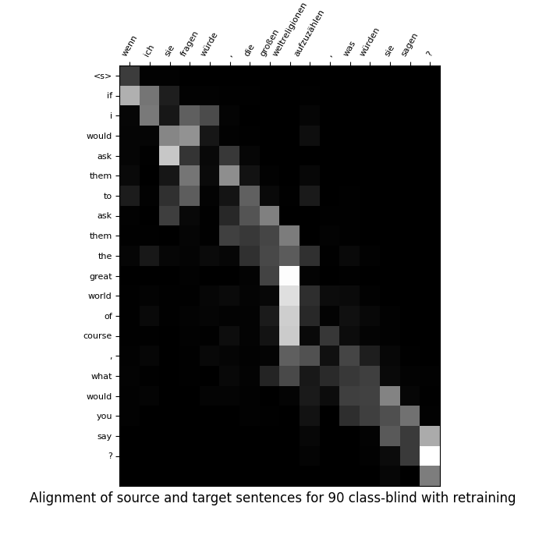
Predicted: If i asked them , the great world of world , what would you say ?
Predicted: If i would ask them to ask them the great world of course , what would you say ?

Slide 41
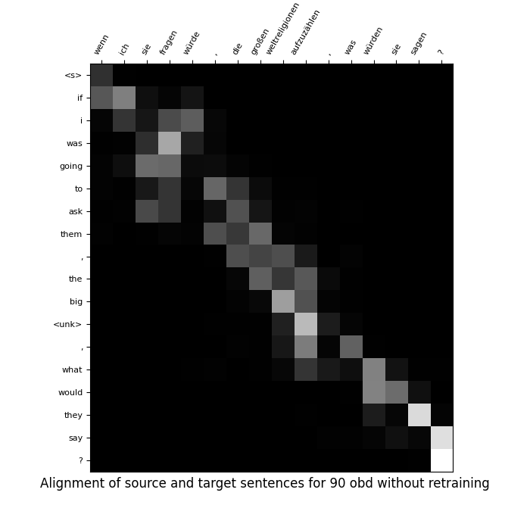
OBD With 90%
without retraining
Source: wenn ich sie fragen würde , die großen weltreligionen aufzuzählen , was würden sie sagen ?
Target: if i asked you to name the great religions of the world , what would you say ?
Predicted: If i was going to ask them , the big <unk> , what would they say ?

Slide 42
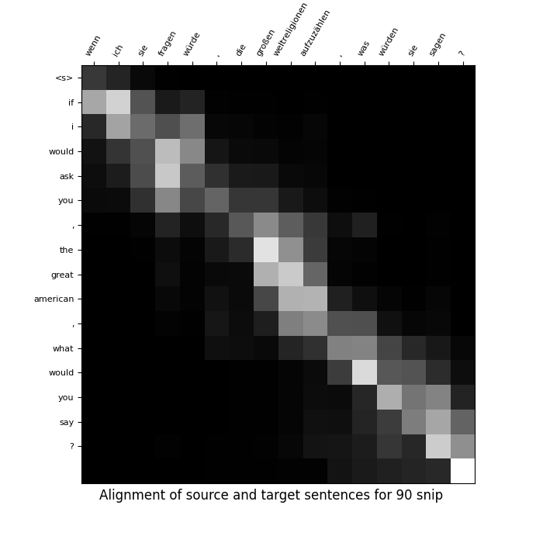
Snip with 90%
Pruning
Source: wenn ich sie fragen würde , die großen weltreligionen aufzuzählen , was würden sie sagen ?
Target: if i asked you to name the great religions of the world , what would you say ?
Predicted: If i would ask you , the great american , what would you say ?

Slide 43
Final Conclusions based on our finding
Class blind is best out of magnitude based prunings
Retraining can improve the model even if pruned randomly
Gradient based methods prune initial layers more (due to less gradient flow to initial layers)
OBD and SNIP perform good on extreme pruning percentages
OBD performs really well even without retraining
Performance of SNIP on NMT task as we found is suboptimal.
We get best results on OBD out of all the pruning methods we tried

Slide 44
References
See, Abigail, Minh-Thang Luong, and Christopher D. Manning. "Compression of neural machine translation models via pruning." arXiv preprint arXiv:1606.09274 (2016).
Luong, Minh-Thang, Hieu Pham, and Christopher D. Manning. "Effective approaches to attention-based neural machine translation." arXiv preprint arXiv:1508.04025 (2015).
Lee, Namhoon, Thalaiyasingam Ajanthan, and Philip HS Torr. "Snip: Single-shot network pruning based on connection sensitivity." arXiv preprint arXiv:1810.02340 (2018).
LeCun, Yann, John Denker, and Sara Solla. "Optimal brain damage." Advances in neural information processing systems2 (1989).
Blalock, Davis, et al. "What is the state of neural network pruning?." Proceedings of machine learning and systems 2 (2020): 129-146.
Wang, Chaoqi, Guodong Zhang, and Roger Grosse. "Picking winning tickets before training by preserving gradient flow." arXiv preprint arXiv:2002.07376 (2020).

Slide 45
Our codebase
Github Link: https://github.com/Statistical-Methods-in-AI-Monsoon-2023/project-optimal-brain-damage
Notion Page: https://pickled-wallaby-800.notion.site/Documentation-630d93bc52214cb5aedfc667b5e5554e?pvs=4
Wandb Logs: https://wandb.ai/optimalbraindamage/projects

Slide 46
Questions?

